Slide 1
Wedged Triangles
Inspired by a C4 June 2016 question and a question in an AQA Further Mathematics paper.

Slide 2
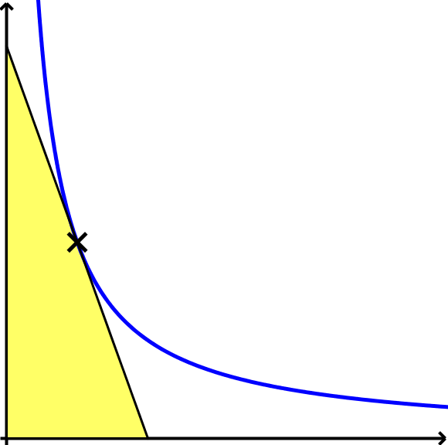
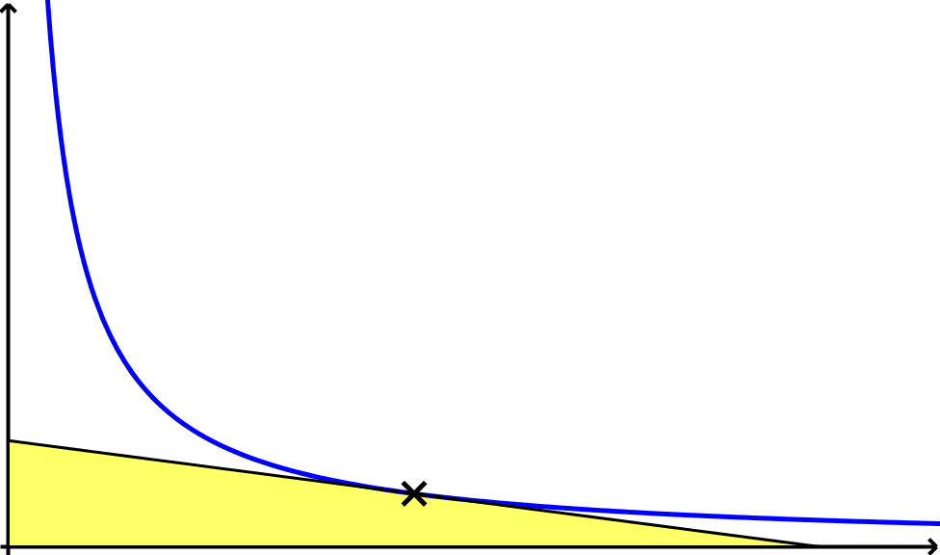












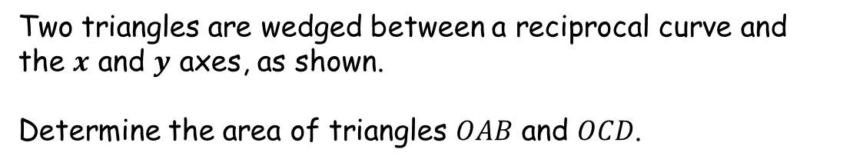


Wedged Triangles
$$y$$
$$y$$
$$A$$
$$y=\frac{k}{x}$$
$$P \left(1,16\right)$$
$$y=\frac{k}{x}$$
$$C$$
$$Q \left(8,2\right)$$
$$O$$
$$B$$
$$x$$
$$O$$
$$D$$
$$x$$
Two triangles are wedged between a reciprocal curve and the $x$ and $y$ axes, as shown.
Determine the area of triangles $OAB$ and $OCD$.

Slide 3


Wedged Triangles
$$y$$
$$y$$
$$A$$
$$k=16×1=16$$
$$y=\frac{k}{x}$$
$$k=2×8=16$$
$$P \left(1,16\right)$$
$$y=\frac{k}{x}$$
$$C$$
$$Q \left(8,2\right)$$
$$O$$
$$B$$
$$x$$
$$O$$
$$D$$
$$x$$
Two triangles are wedged between a reciprocal curve and the $x$ and $y$ axes, as shown.
Determine the area of triangles $OAB$ and $OCD$.

Slide 4


Wedged Triangles
$$y$$
$$y$$
$$A$$
$$y=\frac{16}{x}$$
$$P \left(1,16\right)$$
$$y=\frac{16}{x}$$
$$C$$
$$Q \left(8,2\right)$$
$$O$$
$$B$$
$$x$$
$$O$$
$$D$$
$$x$$
Two triangles are wedged between a reciprocal curve and the $x$ and $y$ axes, as shown.
Determine the area of triangles $OAB$ and $OCD$.

Slide 5
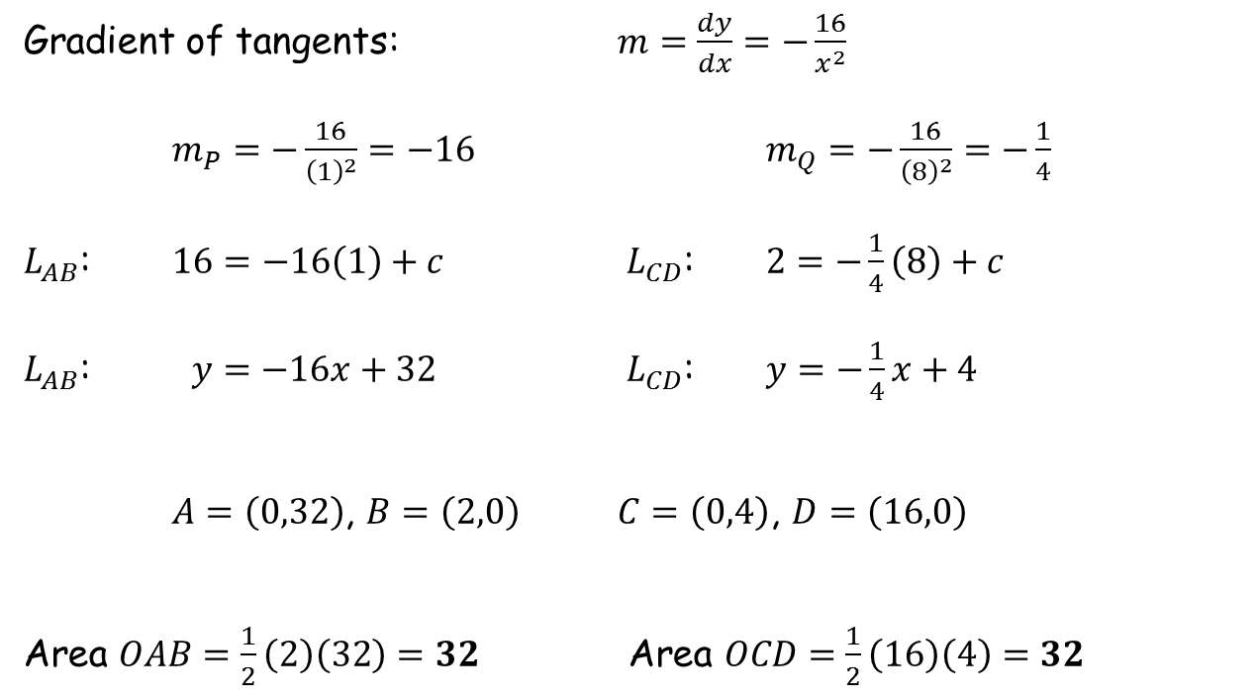
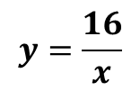


Wedged Triangles
$$y=\frac{16}{x}$$
Gradient of tangents: $m=\frac{dy}{dx}=−\frac{16}{x^{2}}$
$m_{P}=−\frac{16}{{\left(1\right)}^{2}}=−16$ $m_{Q}=−\frac{16}{{\left(8\right)}^{2}}=−\frac{1}{4}$
$L_{AB}$: $16=−16\left(1\right)+c$ $L_{CD}$: $2=−\frac{1}{4}\left(8\right)+c$
$L_{AB}$: $y=−16x+32$ $L_{CD}$: $y=−\frac{1}{4}x+4$
$A=\left(0,32\right)$, $B=\left(2,0\right)$ $C=\left(0,4\right)$, $D=\left(16,0\right)$
Area $OAB=\frac{1}{2}\left(2\right)\left(32\right)=32$ Area $OCD=\frac{1}{2}\left(16\right)\left(4\right)=32$
$$P= \left(1,16\right)$$
$$Q= \left(8,2\right)$$

Slide 6






Wedged Triangles
$$y$$
$$y$$
$$32$$
$$y=\frac{16}{x}$$
$$P \left(1,16\right)$$
$$y=\frac{16}{x}$$
$$32$$
$$4$$
$$Q \left(8,2\right)$$
$$32$$
$$O$$
$$2$$
$$x$$
$$O$$
$$16$$
$$x$$
The areas are the same. Try other points on the curve and repeat.
Can you prove any conjecture that you arrive at?

Slide 7



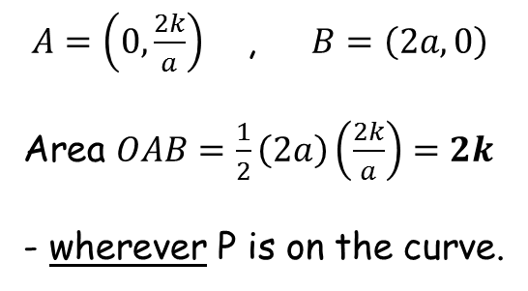






Wedged Triangles
$$y$$
$$y=\frac{k}{x}$$
$$P \left(a,\frac{k}{a}\right)$$
$$A$$
$$2k$$
$$O$$
$$B$$
$$x$$
$m=\frac{dy}{dx}=−\frac{k}{x^{2}}$
$m_{P}=−\frac{k}{a^{2}}$
$L_{AB}$: $\frac{k}{a}=−\frac{k}{a^{2}}\left(a\right)+c$
$L_{AB}$: $y=−\frac{k}{a^{2}}x+\frac{2k}{a}$
$A=\left(0,\frac{2k}{a}\right)$ , $B=\left(2a,0\right)$
Area $OAB=\frac{1}{2}\left(2a\right)\left(\frac{2k}{a}\right)=2k$
- wherever P is on the curve.

Slide 8
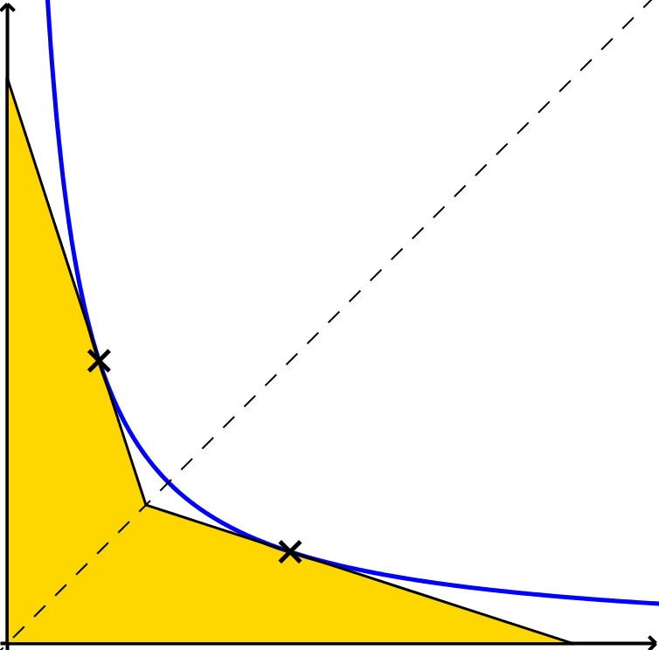



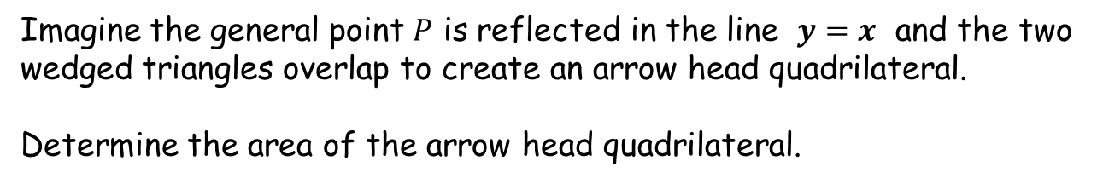




Wedged Triangles
Extension
$$y$$
$$y=\frac{k}{x}$$
$$y=x$$
$$P^{′}$$
$$P \left(a,\frac{k}{a}\right)$$
$$O$$
$$x$$
Imagine the general point $P$ is reflected in the line $y=x$ and the two wedged triangles overlap to create an arrow head quadrilateral.
Determine the area of the arrow head quadrilateral.

Slide 9






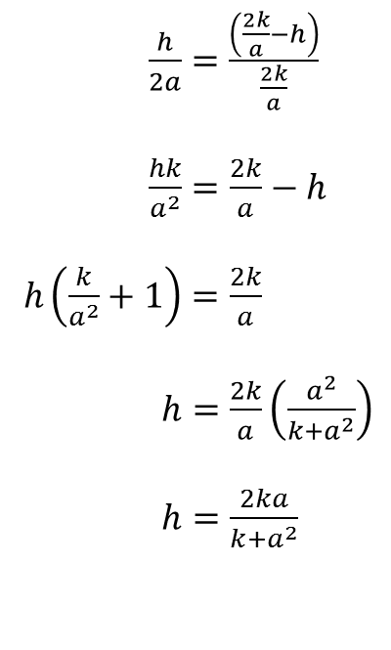

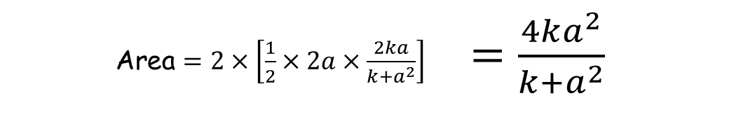
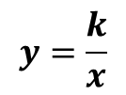





Extension
Wedged Triangles
$$y$$
$$2a$$
$$y=\frac{k}{x}$$
$$2a$$
$\frac{h}{2a}=\frac{\left(\frac{2k}{a}−h\right)}{\frac{2k}{a}}$
$\frac{hk}{a^{2}}=\frac{2k}{a}−h$
$h\left(\frac{k}{a^{2}}+1\right)=\frac{2k}{a}$
$h=\frac{2k}{a}\left(\frac{a^{2}}{k+a^{2}}\right)$
$h=\frac{2ka}{k+a^{2}}$
$$y=x$$
$$P^{′}\left(\frac{k}{a},a\right)$$
$$P \left(a,\frac{k}{a}\right)$$
$$h$$
$$O$$
$$2a$$
$$x$$
$$h$$
$$\frac{2k}{a}$$
Area $=2×\left[\frac{1}{2}×2a×\frac{2ka}{k+a^{2}}\right]$ $=\frac{4ka^{2}}{k+a^{2}}$

Slide 11
RESOURCES

Slide 12
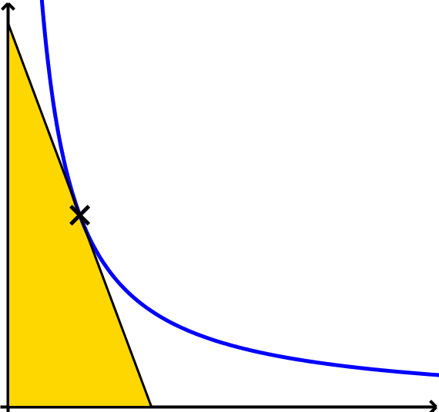
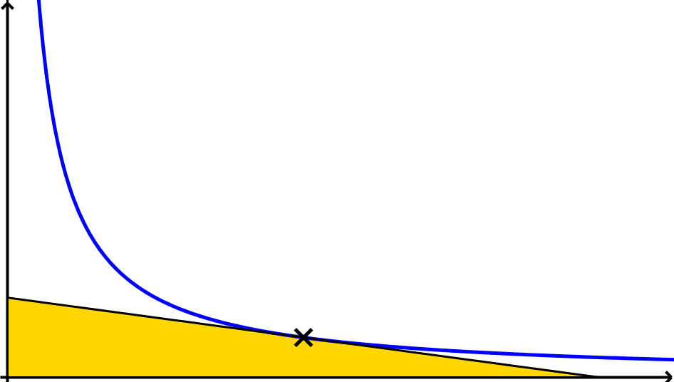


Wedged Triangles
$$y$$
$$y$$
$$A$$
$$y=\frac{k}{x}$$
$$P \left(1,30\right)$$
$$y=\frac{k}{x}$$
$$C$$
$$Q \left(5,6\right)$$
$$O$$
$$B$$
$$x$$
$$O$$
$$D$$
$$x$$
Two triangles are wedged between a reciprocal curve and the $x$ and $y$ axes, as shown.
Determine the area of triangles $OAB$ and $OCD$.
SIC_57

Slide 13


Wedged Triangles
$$y$$
$$y$$
$$A$$
$$y=\frac{k}{x}$$
$$P \left(3,10\right)$$
$$y=\frac{k}{x}$$
$$C$$
$$Q \left(12,2.5\right)$$
$$O$$
$$B$$
$$x$$
$$O$$
$$D$$
$$x$$
Two triangles are wedged between a reciprocal curve and the $x$ and $y$ axes, as shown.
Determine the area of triangles $OAB$ and $OCD$.
SIC_57

Slide 14


Wedged Triangles
$$y$$
$$y$$
$$A$$
$$y=\frac{k}{x}$$
$$P \left(2,25\right)$$
$$y=\frac{k}{x}$$
$$C$$
$$Q \left(5,10\right)$$
$$O$$
$$B$$
$$x$$
$$O$$
$$D$$
$$x$$
Two triangles are wedged between a reciprocal curve and the $x$ and $y$ axes, as shown.
Determine the area of triangles $OAB$ and $OCD$.
SIC_57

Slide 15


Wedged Triangles
$$y$$
$$y$$
$$A$$
$$y=\frac{k}{x}$$
$$P \left(4,12.5\right)$$
$$y=\frac{k}{x}$$
$$C$$
$$Q \left(20,2.5\right)$$
$$O$$
$$B$$
$$x$$
$$O$$
$$D$$
$$x$$
Two triangles are wedged between a reciprocal curve and the $x$ and $y$ axes, as shown.
Determine the area of triangles $OAB$ and $OCD$.
SIC_57

Slide 16


Wedged Triangles
$$y$$
$$y$$
$$A$$
$$y=\frac{k}{x}$$
$$P \left(2,10\right)$$
$$y=\frac{k}{x}$$
$$C$$
$$Q \left(4,5\right)$$
$$O$$
$$B$$
$$x$$
$$O$$
$$D$$
$$x$$
Two triangles are wedged between a reciprocal curve and the $x$ and $y$ axes, as shown.
Determine the area of triangles $OAB$ and $OCD$.
SIC_57

Slide 17


Wedged Triangles
$$y$$
$$y$$
$$A$$
$$y=\frac{k}{x}$$
$$P \left(1,20\right)$$
$$y=\frac{k}{x}$$
$$C$$
$$Q \left(10,2\right)$$
$$O$$
$$B$$
$$x$$
$$O$$
$$D$$
$$x$$
Two triangles are wedged between a reciprocal curve and the $x$ and $y$ axes, as shown.
Determine the area of triangles $OAB$ and $OCD$.
SIC_57

Slide 18


Wedged Triangles
$$y$$
$$y$$
$$A$$
$$y=\frac{k}{x}$$
$$P \left(3,25\right)$$
$$y=\frac{k}{x}$$
$$C$$
$$Q \left(15,5\right)$$
$$O$$
$$B$$
$$x$$
$$O$$
$$D$$
$$x$$
Two triangles are wedged between a reciprocal curve and the $x$ and $y$ axes, as shown.
Determine the area of triangles $OAB$ and $OCD$.
SIC_57

Slide 19


Wedged Triangles
$$y$$
$$y$$
$$A$$
$$y=\frac{k}{x}$$
$$P \left(5,15\right)$$
$$y=\frac{k}{x}$$
$$C$$
$$Q \left(10,7.5\right)$$
$$O$$
$$B$$
$$x$$
$$O$$
$$D$$
$$x$$
Two triangles are wedged between a reciprocal curve and the $x$ and $y$ axes, as shown.
Determine the area of triangles $OAB$ and $OCD$.
SIC_57

Slide 20


Wedged Triangles
$$y$$
$$y$$
$$A$$
$$y=\frac{k}{x}$$
$$P \left(1,40\right)$$
$$y=\frac{k}{x}$$
$$C$$
$$Q \left(8,5\right)$$
$$O$$
$$B$$
$$x$$
$$O$$
$$D$$
$$x$$
Two triangles are wedged between a reciprocal curve and the $x$ and $y$ axes, as shown.
Determine the area of triangles $OAB$ and $OCD$.
SIC_57

Slide 21


Wedged Triangles
$$y$$
$$y$$
$$A$$
$$y=\frac{k}{x}$$
$$P \left(2,20\right)$$
$$y=\frac{k}{x}$$
$$C$$
$$Q \left(10,4\right)$$
$$O$$
$$B$$
$$x$$
$$O$$
$$D$$
$$x$$
Two triangles are wedged between a reciprocal curve and the $x$ and $y$ axes, as shown.
Determine the area of triangles $OAB$ and $OCD$.
SIC_57

Slide 22


Wedged Triangles
$$y$$
$$y$$
$$A$$
$$y=\frac{k}{x}$$
$$P \left(3,30\right)$$
$$y=\frac{k}{x}$$
$$C$$
$$Q \left(15,6\right)$$
$$O$$
$$B$$
$$x$$
$$O$$
$$D$$
$$x$$
Two triangles are wedged between a reciprocal curve and the $x$ and $y$ axes, as shown.
Determine the area of triangles $OAB$ and $OCD$.
SIC_57

Slide 23


Wedged Triangles
$$y$$
$$y$$
$$A$$
$$y=\frac{k}{x}$$
$$P \left(2,45\right)$$
$$y=\frac{k}{x}$$
$$C$$
$$Q \left(20,4.5\right)$$
$$O$$
$$B$$
$$x$$
$$O$$
$$D$$
$$x$$
Two triangles are wedged between a reciprocal curve and the $x$ and $y$ axes, as shown.
Determine the area of triangles $OAB$ and $OCD$.
SIC_57

Slide 24
Wedged Triangles
Extension
$$y$$
$$y=\frac{k}{x}$$
$$y=x$$
$$P^{′}$$
$$P \left(a,\frac{k}{a}\right)$$
$$O$$
$$x$$
Imagine the general point $P$ is reflected in the line $y=x$ and the two wedged triangles overlap to create an arrow head quadrilateral.
Determine the area of the arrow head quadrilateral.

Slide 25
Wedged Triangles
Extension
$$y$$
$$y=\frac{k}{x}$$
$$y=x$$
$$P^{′}$$
$$P \left(a,\frac{k}{a}\right)$$
$$O$$
$$x$$
Imagine the general point $P$ is reflected in the line $y=x$ and the two wedged triangles overlap to create an arrow head quadrilateral.
Determine the area of the arrow head quadrilateral.

